Slide 1

Planet Assessment Application
Arnab Chakraborty
Current Organization :- IBM
Role :- Application Developer (Mobile:iOS)
India

Slide 2


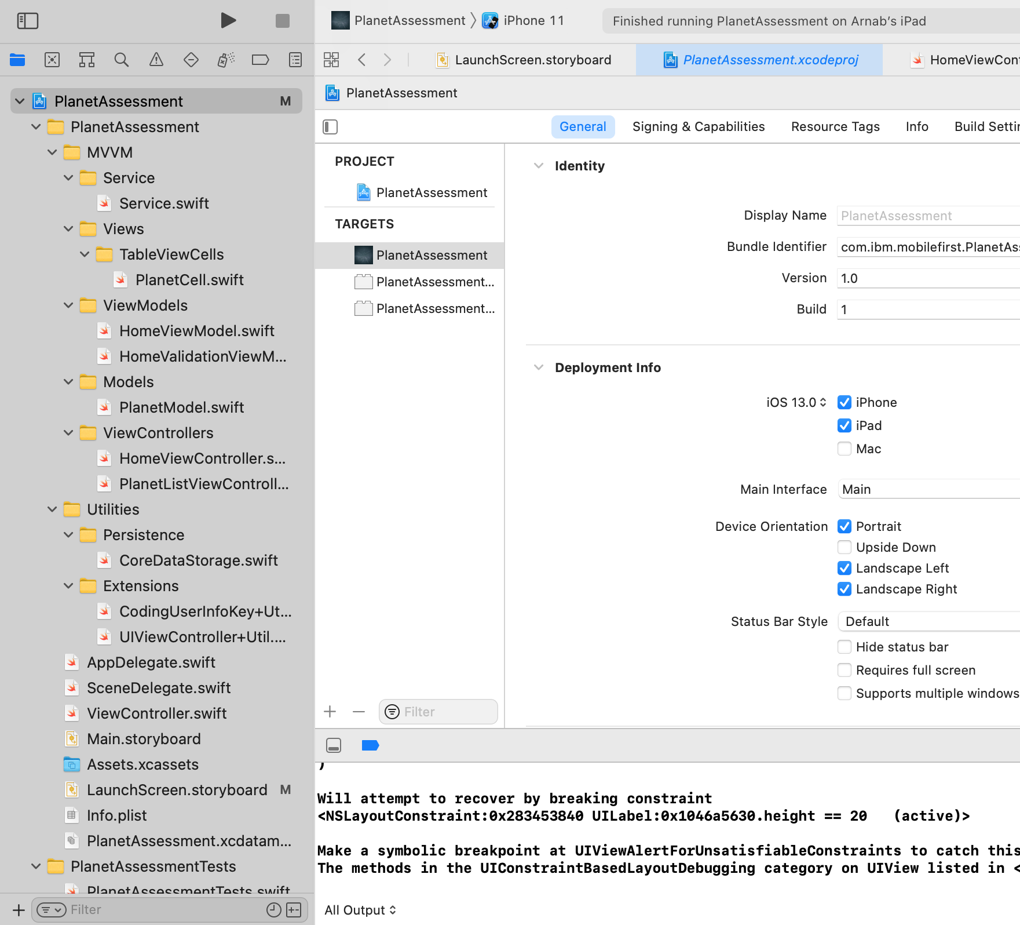
User manual And Application Guide
Application Code level Hierarchy Setup

Slide 3
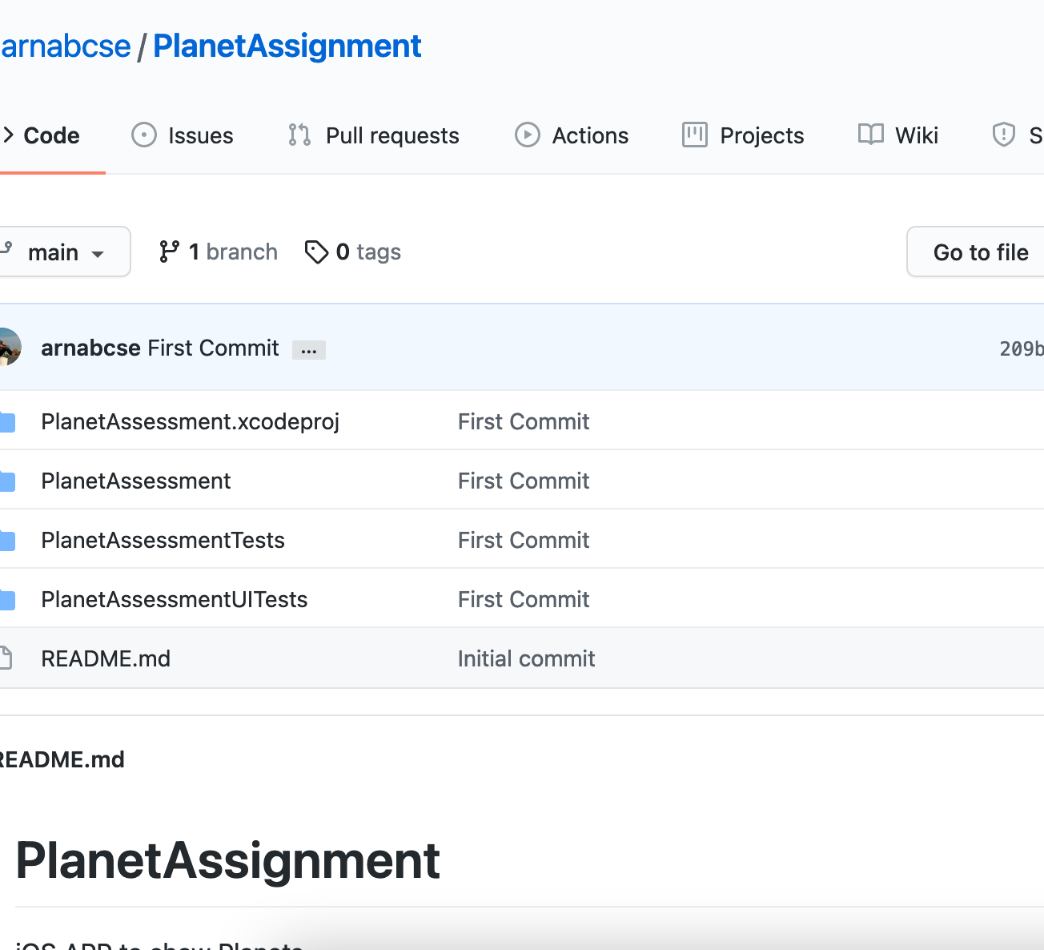
GitHUB Code Base Link
https://github.com/arnabcse/PlanetAssignment
https://github.com/arnabcse/PlanetAssignment

Slide 4
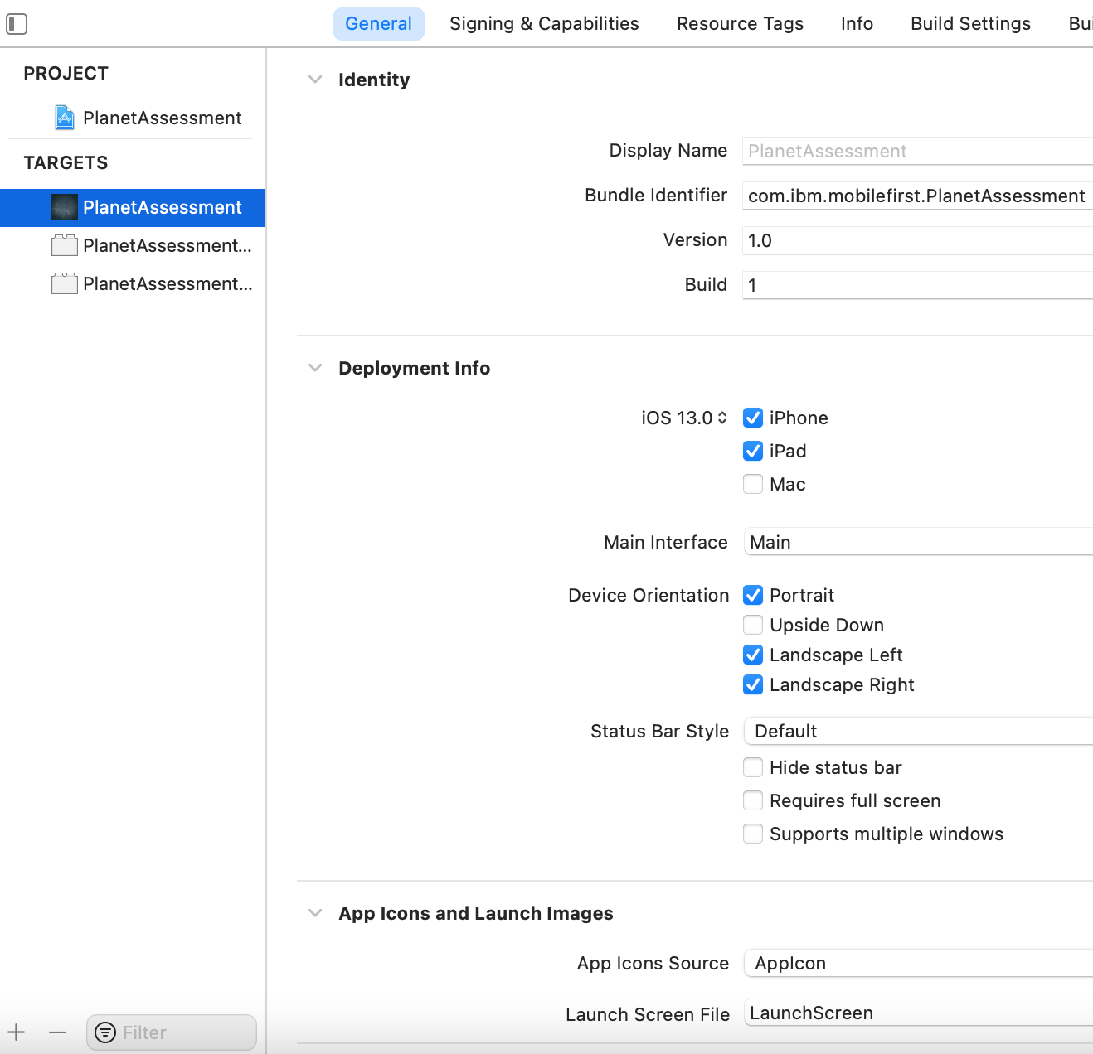
Application iOS Deployment Target & Device Family
Minimum iOS Version 13.0
Maximum iOS Version Latest & Onwards
Target Device – iPHONE & iPAD

Slide 5
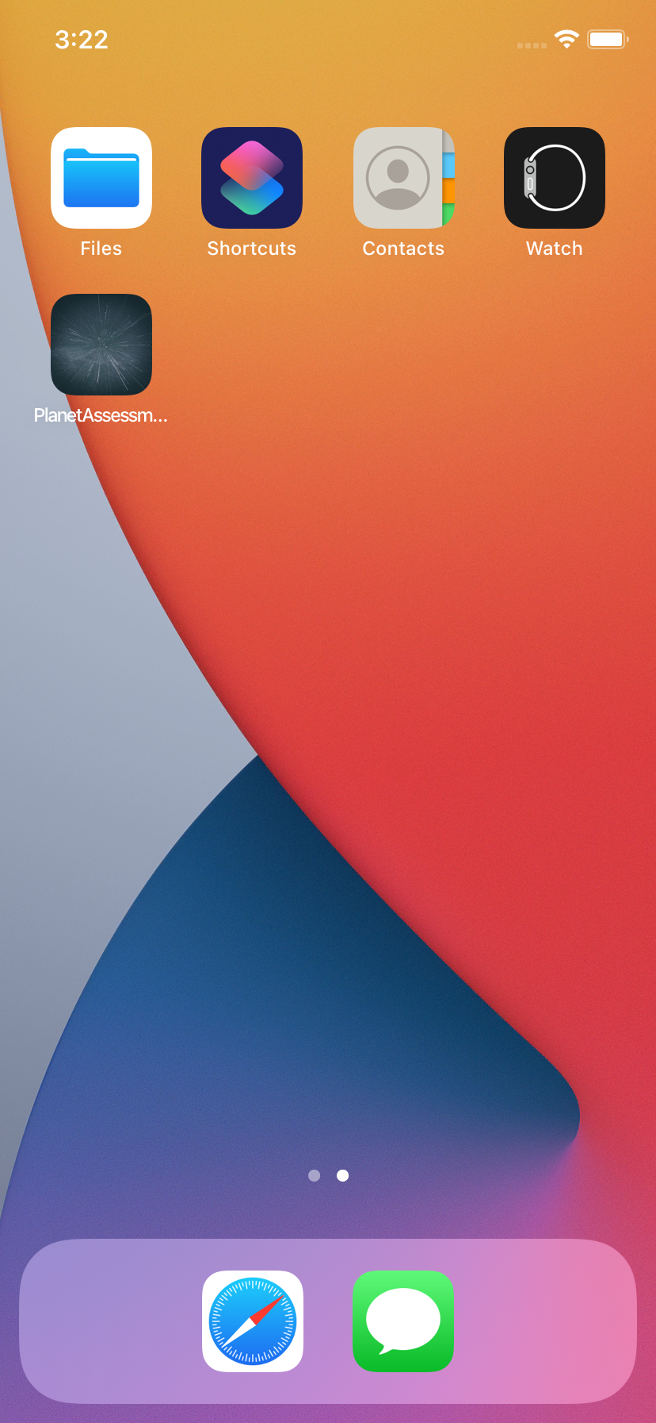
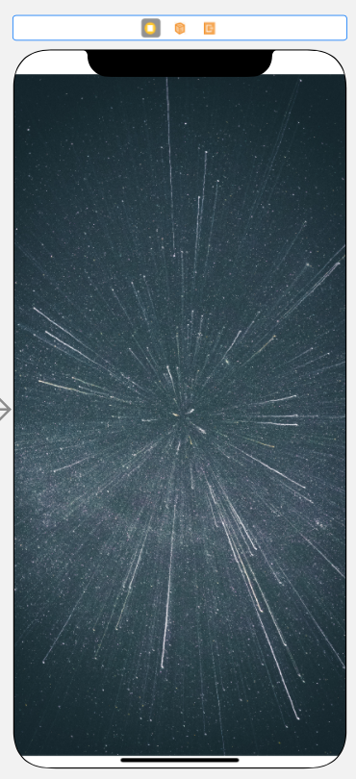
App Icon & Launch Screen
Launch Screen
App ICON

Slide 6
Application Business Functionality
Application is to show Planet Name and Few of the details for individual planet.
Planet data will be fetched from the server as REST API fetch.
Whole application is to support Offline Functionality for the USER.
User need one time to download the data of all Planets from the server to see all of them.
Only that DOWNLOAD time Device should be in Network Reachable Condition to download data from Server.
Rest of the time Application will run on basis of its Persistent Store Data which is saved from the server.
Download functionality here is also like Refresh, so each time the Persistent Store Data will be updated if User Tries to Download.
User can’t see View All Planet Data, if Application does not Download the data from the server and Stored it in Persistent Store.
Analysis Feature has been introduced to show some analytical Model data (Development in Progress)

Slide 7



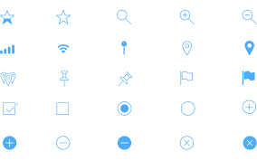
Technology & Framework USED
SWIFT
XCODE
UIKIT
CoreData

Slide 8
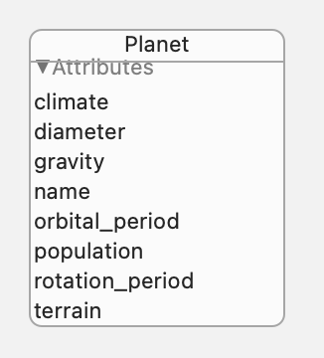
COREDATA Persistent STORE
CoreData Persistent Store Entity Relationship Diagram

Slide 9
Application Screen Flow
Offline Mode
Online + Offline Mode
Offline Mode
Screen Flow
Launch Screen
Home Screen
Planet List Screen

Slide 10
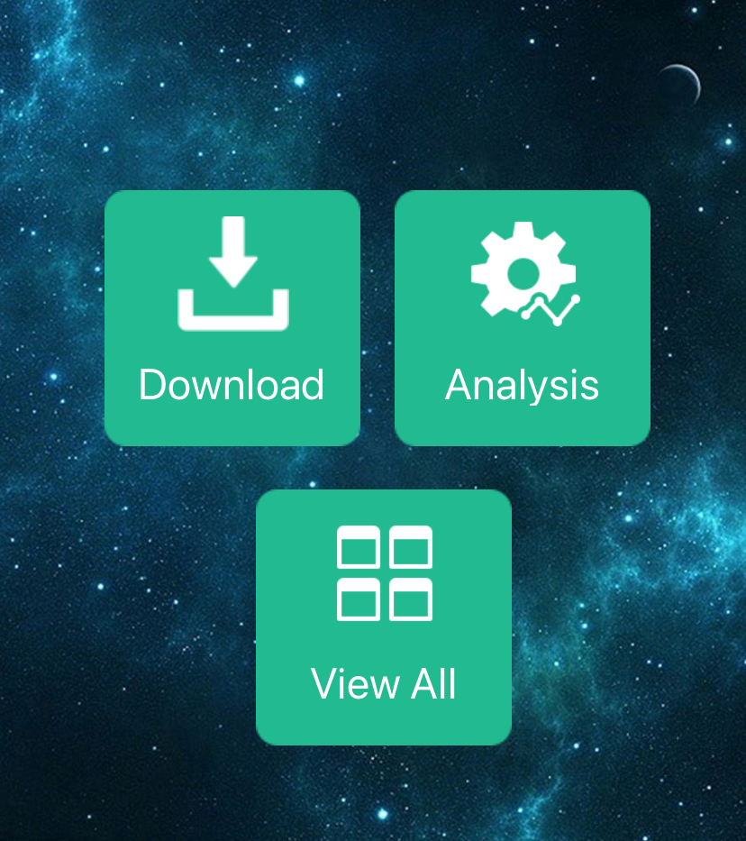
Home Screen
Features:-
Download:- To Download the Data From the Server (Online Mode)
View ALL:- To view the List of Planets (Offline Mode)
Analysis :- To View some Analytical System and Application Information (Development In Progress)

Slide 11
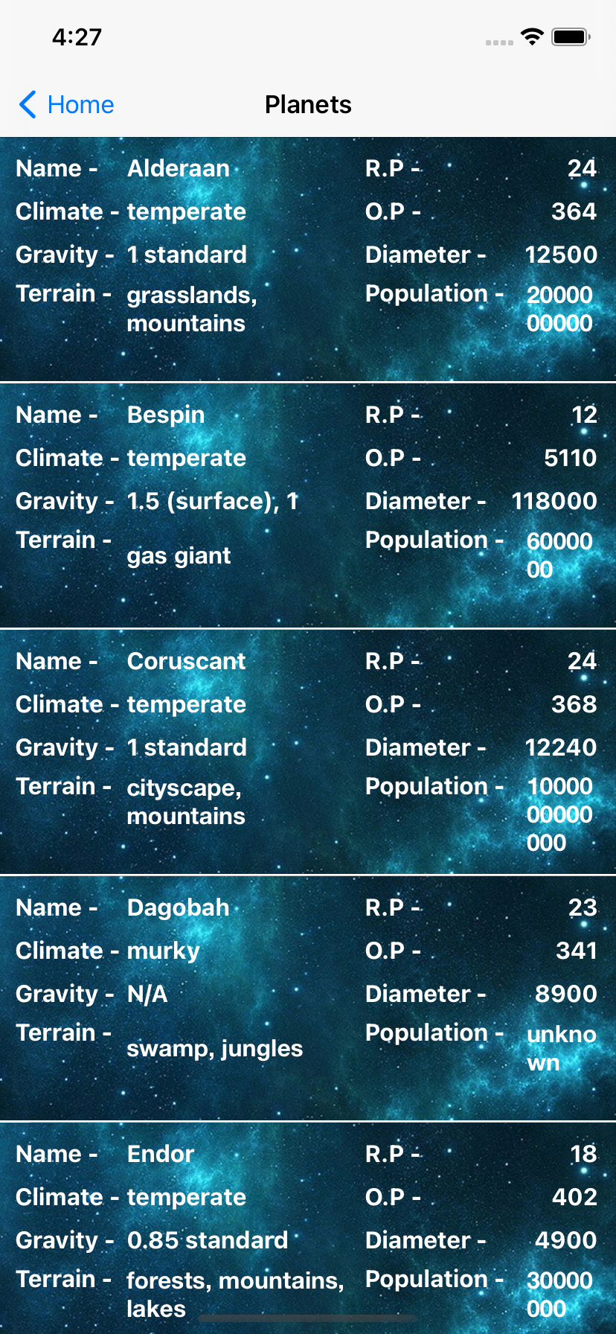
Planet List Screen
Features:-
This screen shows the List of All Planets and Some Basic Information's regarding each planet.
Information :-
Name :- name of The planet
Climate:- climate information of The Planet
Gravity:- gravity type of The Planet
Terrain:- terrain type of The Planet
R.P:- rotation period count of The Planet
O.P:- orbital period count of the Planet
Diameter:- diameter value of the Planet
Population:- population count of The Planet

